Slide 1
WMA IT CTO Review
Target State Architecture – Post Trade Services
September 2010
Notes:
0

Slide 2
Agenda
Overview / Recap of Analysis done to date (Arch Lead / Dev lead)
Target State Vision / Overview (Arch Lead / Dev lead)
Target State Options – discuss what options or decisions need to made
Impacts of the target state on other areas (Group Discussion)
Plan and Timeline
Plan for achieving the target state, costs and timeline
Impacts / Dependencies with other areas
Key Questions
What is the impact of outsourcing implementation option on target state for post trade services?
Should there be a common clearance and settlement function or do we need separate once for Government and OTC transactions
Should we eliminate branch in account number
Key Principles
Elimination of redundant functions wherever possible (e.g. holiday calendars, accrued interest)
Elimination of hard-coded business logic in favor of business process management for common business services
Eliminate batch cycles in favor of real-time event-based processing; create business events rather than journal entries
Favor front-end editing rather than post-processing corrections (eg in Bookkeeping)
Standardization of field sizes for amount type and quantity type fields across back office systems by currency
Automate exception-based processing through workflow to enable straight through processing
Source systems should be capable of reversing their transactions
Standardization of transaction identifiers
24x7 availability of transactions for Financial Advisors

Slide 3
Post Trade Services
2

Slide 4
Post Trade Services – Operational Position Keeping Overview
Overview | This area covers bookkeeping, real time position and balances and other operational position and balance keeping systems, Clearance and Settlement, Corporate Actions, ACATs, Billing&Fees Tax Reporting, Trade Booking, Margin CBM components: Position Data Services::Operational Position Keeping Post Trade Services::Trade Support, Operational Services, Reconciliation, Inventory management Services
Current State
Business Drivers
Functional Issues:
No single authoritative intraday source of real-time position and balance
Back Office systems are not multi-currency capable
Many instance of inadequate field sizes in Back Office systems
P&S commissions
BK fractional shares
P&S has no real-time capability
C&S has many manual processes
Billing systems lack flexibility
Siloed applications, forcing manual work-arounds in order to achieve interoperability
Lack of standardized configurability of product handling across back-office
Lack of a uniform transaction identifier
Technical Issues:
Bookkeeping outdated technology 35+ years old.
Bookkeeping contains an embedded margin function
P&S has Functional redundancies with OET
C&S is difficult to maintain, due to non modular structure
No centralized margin function
Multiple non-integrated billing systems
Multiple systems to process corporate Actions
Many reconciliation systems
Hard coded business rules throughout the back office
No standardized way to create statement descriptions for transactions
Reduce operational risk by removing complicated outdated technology
Improved handling of fractional shares and standardize quantity and amount field sizes
Accurate real-time view of client position and balance to improve client/FA experience, reduces risks, and increases opportunities
Post Trade multi-currency capability
Reduced reliance on time consuming manual journal entries
Improved straight-thru processing capability
Removal of embedded wire code in account, due to system integration complexities
Standardization of field sizes for quantities and amounts.
True as-of capability
Target State Requirements

Slide 5
Post Trade Services – Operational Position Keeping Overview
Overview | This area covers bookkeeping, real time position and balances and other operational position and balance keeping systems, Clearance and Settlement, Corporate Actions, ACATs, Billing&Fees Tax Reporting, Trade Booking CBM components: Position Data Services::Operational Position Keeping Post Trade Services::Trade Support, Operational Services, Reconciliation, Inventory management Services
Current State
Target State Requirements
Functional Requirements:
Multi-currency capable
Eliminate/reduce the need for journal entries
Any entry that feeds real-time balance and position doesn't need to feed bookkeeping. End of day should be the books and records.
All corrections and cancellations are made through source systems
Enhanced field sizes to support large commissions and fractional shares
Single authoritative real-time position and balance capability
Provide an implementation for all WMA sub-ledgers
Any system originating transactions should be capable of cancelling them (Eliminate GJOWs)
Parameter driven processing
Capability of doing true as-of processing
Exception processes should be workflow enabled. Back office to back office and front office to back office
Universal Account Number
Technical Requirements:
Reduce risk inherent in systems with outdated technology (C&S, Bookkeeping, P&S)
Rationalization of operational position and balance functions
Develop a separate margin function
Single flexible billing system
Elimination of redundant systems
Externalization of business logic
All applications need to be scalable and highly available

Slide 6

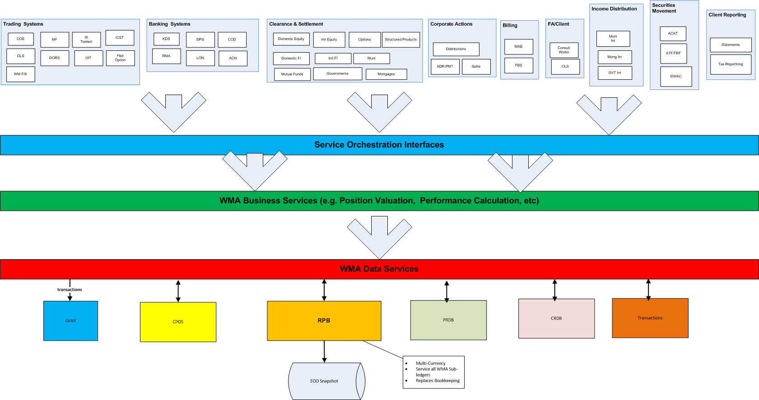
Current State vs. Target State (Conceptual)
Older technology risk
Redundant processing of the same trade in silo-ed applications
Real-time Positions & Balances does not contain all transactions (eg Banking) and multiple copies exist outside RPB
CPOS is not used by all systems as source for Client Positions (e.g. statements)
Event-driven, near realtime transactions managed through a common business services layer and services orchestration for consistent one-time-only processing and shared common functions such as calculations and alerts
Data services layer to enforce "golden sources" and allow for greater flexibility
Can be implemented either internally or externally
.

Slide 7



Target State Architecture Flow (Implementation Option 1)
IB Component
Modified/Replaced
Client Platform
Order Management
Positional Data Services
CRM
Client Reporting
Order Management
Order Execution
Operational Position Keeping
Valuation
Ledger
X
COE
Bookkeeping
New CRM
OLS
Consultworks
OLT
RPB
Gear
OET
Oscar
RPB is real-time ODS, includes Banking Cash Balances, Multi-currency
OLS
Account Opening
PMR
TopCat
CPOS
PMR
Mobile
OET
PRDB
CPOS
CRDB
MAC
Business Services & Data Layer
CPOS for Reporting All Client Positions
Services Layer
Statements fed from CPOS
Margin
Client Statements
Re-tool Core Post Trade Services
ACATS
IS Toolset
Tefra
Envestnet
Poss re-use Break-recon system
Research
P&S
Consultworks
Reg Reporting
UBS FA
Cash
Mobile
Wealth Management Platform
Post Trade Services
Advisory Services
Financial Profile Management
Research
Trade booking & Enrichment
Settlement
Margin Management
Reconciliations

Slide 8
Target State Architecture Flow (Implementation Option 2)
IB Component
Broadridge
Client Platform
Order Management
Positional Data Services
CRM
Client Reporting
Order Management
Order Execution
Operational Position Keeping
Valuation
Ledger
COE
New CRM
Broadridge
OLS
Consultworks
OLT
Bookkeeping
Account Opening
OET
Oscar
BPSA
OLS
PMR
TopCat
CPOS
Gear
Mobile
PMR
OET
PRDB
CPOS
CRDB
MAC
Business Services & Data Layer
Feeds
CPOS for Reporting All Client Positions
Services Layer
Broadridge Data Stores
CRDB
PRDB
BPSA
Broadridge Transactions
Statements fed from CPOS
Some Front-end systems will be integrated directly with ConsultWorks e.g., ACATS
Margin
Client Statements
Reference Data copies must stay in sync or integrate in real-time through external service calls
ACATS
Tefra
Breaks and Reconciliation
IS Toolset
P&S
Consultworks
Envestnet
Reg Reporting
UBS FA
Cash
Research
Mobile
Wealth Management Platform
Post Trade Services
Advisory Services
Financial Profile Management
Research
Trade booking & Enrichment
Settlement
Margin Management
Reconciliations

Slide 9
Conceptual Target State (Enhance Existing Systems)
Implementation of WMA post trade business functions using business services available from all platforms.
Client applications call Service Orchestration Interfaces
Reuse of business services across applications
Data services for access to operational data stores
True As-of processing capability
Single source of real-time position and balance
All WMA sub-ledgers
8

Slide 10
Conceptual Target State (Columbus)
Implementation of WMA post trade business functions using vendor back office systems.
Data services for access to operational data stores at WMA and vendor
Client applications call Service Orchestration Interfaces
Reuse of business services across applications
ACATs, Corporate Actions, Clearance and Settlement etc
All WMA sub-ledgers
Single source of real-time position and balance
9

